Slide 1

Department of Computer Science and Engineering
Identifying Ships Using Satellite Images by
Deep Learning Algorithms
PRESENTED BY
Rukmini Gayathri Tadavarthi (20471A0561)
Asritha Meda (20471A0535)
Sai Harsha Bandi (20471A0506)
Under the Guidance of,
Dr.Moturi.Sireesha _{B.Tech,M.Tech,Ph.D}
Professor
Department of Computer Science and Engineering,
Narasaraopeta Engineering College (Autonomous),
Narasaraopet- 522 601.

Slide 2
OUTLINE
Abstract
Introduction
Literature Survey
Research Gaps
Problem Statement
Objectives
Block Diagram / Flow Diagram
Methodology
Implementation
Results and Analysis
Conclusion & Future Scope
References
Question and Answers
Acknowledgements

Slide 3
ABSTRACT
When using remote sensing pictures for marine security, ship detection is essential. The deep learning method for identifying ships from satellite photos is covered in this research. In order to achieve integrity Hashing is included. This model makes use of a supervised method for classifying images, and then use You Only Look Once version 3 (YOLOv3) for object recognition and feature extraction from deep CNN. Using class labels, semantic segmentation and picture segmentation are used to determine the object category of each pixel. Next, with the satellite image's bounding box is defined and helps us to identify the position of ship and ship count. Then, the concept of hashing using SHA- 256 is applied in conjunction with the ship count and location of bounding box in satellite image.A dataset of around 2,30,000 photos from Kaggle Ships is used to test the suggested model.
30% of the data is used for testing, while the remaining 70% is used for training. The bounding box location and the ship count are the input data used by the hash algorithm. The proposed model achieves integrity by using SHA-256. This model allows secure transmission of highly confidential images.

Slide 4
INTRODUCTION
Detection and secure analysis of ships in satellite imagery to enhance marine security.
Utilizes Deep Learning for ship detection in remote sensing satellite images.
Supervised image classification is employed initially to classify images.
Object detection is performed using You Only Look Once version 3 (YOLOv3) for feature extraction from deep Convolutional Neural Networks (CNN).
Applies the SHA-256 algorithm for hashing.
Hashing is done in conjunction with ship count and the location of bounding boxes in satellite images.

Slide 5
LITERATURE SURVEY
No | Title | Author | Journal Name & Year | Methodology Adapted | Key Findings | Gaps
1 | Method research on ship detection in remote sensing image based on Yolo algorithm | Li, X.; Cai, K | http://doi.org/10.1109/ispds51347.2020.00029 ,2020 | Feature Extraction, Clustering Algorithms | No Tolerance to noise | No detailed information regarding layers of detection
2 | Enhanced YOLO v3 Tiny Network for Real-Time Ship Detection From Visual Image | HAO LIANBING DENG1 , CHENG YANG2 , JIANBO LIU2 | http://doi.org/10.1109/ACCESS.2021.3053956 , 2021 | Enhanced YOLOV3 | Usage of Video frames in order to identify ships | Limitations of video fames and implementations
3 | Machine learning-based ship detection and tracking using satellite images for maritime surveillance | Wang, Y.; Rajesh, G.; Raajini, X.M.; Kritika, N.; Kavinkumar, A.; Shah | http://doi.org/10.3233/AIS-210610 , 2021 | SVM, HOG, Decision tree, Remote sensing, satellite images | Used Ship detection Tracking Filter | No detailed information about how the tracking takes place and the usage of ADI
4 | Attention Mask R-CNN for Ship Detection and Segmentation From Remote Sensing Images | Nie, X.; Duan, M.; Ding, H.; Hu, B.; Wong, E.K. A | http://doi.org/10.1109/ACCESS.2020.2964540 ,2021 | Segmentation classifier, Candidate Selection | Used R-CNN model to shorten the distance b/w upper layer and bottom layer | Here the accuracy of the model and confusion matrix is low

Slide 6
LITERATURE SURVEY
No | Title | Author | Journal Name & Year | Methodology Adapted | Key Findings | Gaps
5 | Ship Detection From Optical Satellite Images Based on Sea Surface Analysis | Yang, G.; Li, B.; Ji, S.; Gao, F.; Xu, Q. | https://ieeexplore.ieee.org/document/6578567 , 2021 | Usage of SAR and AIS | Satellites, Optical Sensors, Remote Sensing | It works only for the homogeneous layer

Slide 7
RESEARCH GAPS
Works only for the Homogeneous layers.
Limited Video Frames.
No detailed information on how the tracking place.

Slide 8
PROBLEM STATEMENT
Optimizing Ship Detection in Satellite Imagery and working with large amount of data by ensuring secure transmission of confidential Satellite Imagery in real-time Ship Detection and Classification.

Slide 9
OBJECTIVES
Object Detection with YOLOv3
Model Testing on Kaggle Ships Dataset
Security Enhancement
Count of ships present within a satellite image
Assign unique hash value to each ship detected

Slide 10
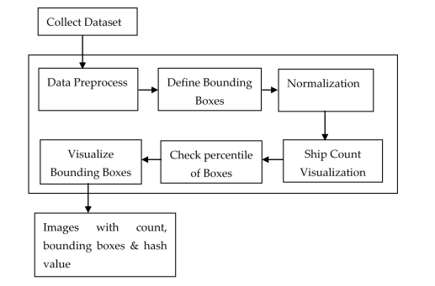
BLOCK DIAGRAM OR FLOW DIAGRAM

Slide 11
METHODOLOGY
The model is fed using Kaggle “air bus ship detection” dataset.
The dataset consists of only two attributes, namely image ID and encoded pixels, which are used for the ship detection and visualization purpose.
YOLOv3 model:
There are 7 modules in this project. Where every single module performs certain task.
Module-1: The model uses the data, which is obtained from Kaggle airbus ship detection dataset.
Model-2 : Finding unique images. The model then focuses on obtaining unique images to improve the efficiency and accuracy.
Module-3 : Function declaration to encode bounding boxes.
Module-4 : Normalize and Drop-encoded pixels. For the purpose of dropping the encoded pixels, drop function is used, which is defined in the Pandas library.

Slide 12
METHODOLOGY
Module-5 : This module removes boxes that are less than 1 percentile. The model finds that there in the range of (0-1) these encoded pixels are removed from the data set, and as a next step, distribution of the ships is evaluated.
Module-6 : It performs downsampling. Since there is large volume of data, only 1000 images from each class are considered for evaluation purpose. This can be done by the help of lambda function.
Module-7 : It includes hashing based on the count of the ships and the position of the bounding box within the image dimensions; a hash value is computed and displayed on top of the output.
K-Means:K-means clustering is used in ship detection by segmenting satellite or radar images into clusters, with ship-like clusters representing vessels against the background, aiding in automated ship detection and tracking.
R-CNN:R-CNN (Region-based Convolutional Neural Network) is utilized in ship detection by first proposing regions of interest, then classifying and refining them through convolutional neural networks, enabling accurate identification and localization of ships in images.

Slide 13
IMPLEMENTATION
Software Specifications:
Browser: Any latest browser like Chrome
Operating System: Windows 7 Server or later
Python (COLAB)
Hardware Specifications:
Processor: Intel® Dual Core 2.0GHz minimum
Hard Disk: 1TB minimum
RAM: 8GB or more

Slide 14
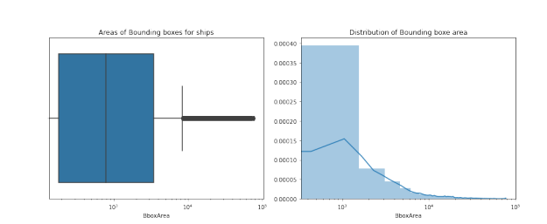
RESULTS & ANALYSIS
After performing the pre-processing techniques and dropping the empty images we have plotted the graph shown in Fig 1.
Fig 1. Areas of Bounding Boxes for ships

Slide 15
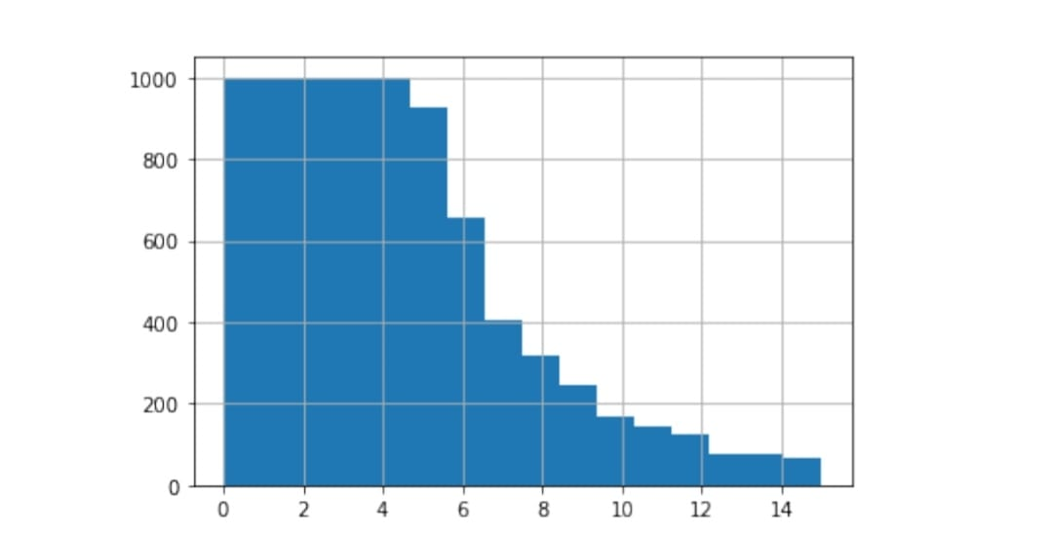
Since the data set volume is very high, we are down sampling to select 1000 images from each of the classes(Where more than 1000) as shown in fig 2.
Fig 2. Class distribution after Down Sampling

Slide 16
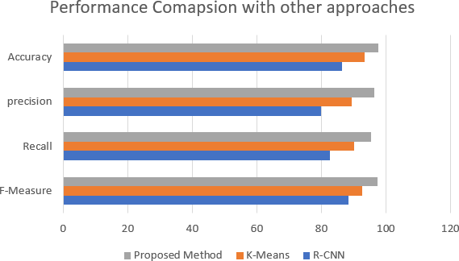
The Fig 3 depicts the performance comparison of K-Means,R-CNN,and YOLOv3 algorithms.
Fig 3.Comparison of model performance with other approaches
YOLOV3 has given an highest accuracy of 97% in identifying ships from satellite images as it is going to detect the objects in three levels.

Slide 17
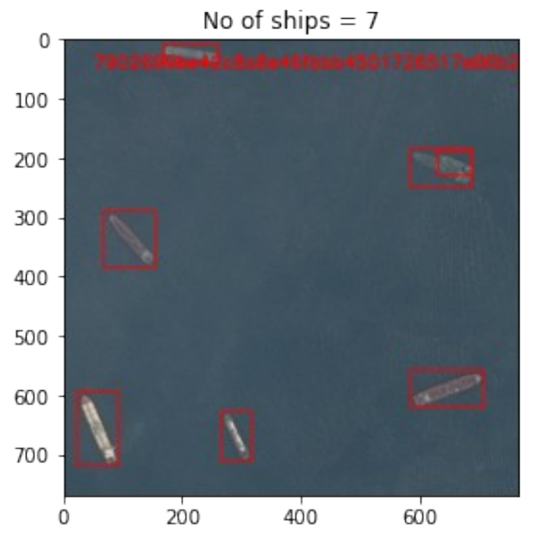
The figure 4 shows the Hashing Value along with Count of ships.
Fig 4. Hashing Value along with Count of ships
SHA-512 algorithm, is used to generate the hashing value. Using a brute force strategy, it would take 2^256 time to decode the hash value without the key.
we have used the hash lib encoding algorithm from SHA-512 library, which provides the ships' placements and their value as a count.

Slide 18
CONCLUSION and FUTURE SCOPE
CONCLUSION :
The developed model is accurate with real-time data and performs well under adverse climatic conditions due to the use of YOLOv3, which performs detection at three different layers.
The proposed bounding box function helps in accurately tying the ships and bounding boxes together.
By using this approach, more unique and import classes of data can be closely visualized.
Higher efficiency can be observed in case of adverse climatic conditions.
FUTURE SCOPE :
In future,it is proposed to extend the model with video inputs as well.

Slide 19
REFERENCES
Li, X.; Cai, K. Method research on ship detection in remote sensing image based on Yolo algorithm. In Proceedings of the International Conference on Information Science, Parallel and Distributed Systems (ISPDS), Xi’an, China, 14–16 August 2020; pp. 104–108. [CrossRef]
Li, H.; Deng, L.; Yang, C.; Liu, J.; Gu, Z. Enhanced YOLO v3 Tiny Network for Real-Time Ship Detection from Visual Image. IEEE Access 2021, 9, 16692–16706. [CrossRef]
Wang, Y.; Rajesh, G.; Raajini, X.M.; Kritika, N.; Kavinkumar, A.; Shah, S.B.H. Machine learning-based ship detection and tracking using satellite images for maritime surveillance. J. Ambient Intell. Smart Environ. 2021, 13, 361–371. [CrossRef]
Hong, Z.; Yang, T.; Tong, X.; Zhang, Y.; Jiang, S.; Zhou, R.; Han, Y.; Wang, J.; Yang, Y.; Liu, S. Multi-Scale Ship Detection from SAR and Optical Imagery Via a More Accurate YOLOv3. IEEE J. Sel. Top. Appl. Earth Obs. Remote Sens. 2021, 14, 6083–6101. [CrossRef]
Bo, L.I.; Xiaoyang, X.I.E.; Xingxing, W.E.I.; Wenting, T.A.N.G. Ship detection and classification from optical remote sensing images: A survey. Chin. J. Aeronaut. 2021, 34, 145–163.
Nie, X.; Duan, M.; Ding, H.; Hu, B.; Wong, E.K. Attention Mask R-CNN for Ship Detection and Segmentation from Remote Sensing Images. IEEE Access 2020, 8, 9325–9334. [CrossRef]
Yang, G.; Li, B.; Ji, S.; Gao, F.; Xu, Q. Ship Detection from Optical Satellite Images Based on Sea Surface Analysis. IEEE Geosci. Remote Sens. Lett. 2013, 11, 641–645. [CrossRef]

Slide 20
Hannevik, T.N.; Olsen, O.; Skauen, A.N.; Olsen, R. Ship detection using high resolution satellite imagery and space-based AIS. In Proceedings of the 2010 International WaterSide Security Conference, Carrara, Italy, 3–5 November 2010; pp. 1–6. [CrossRef]
Wu, H.; Zhang, H.; Zhang, J.; Xu, F. Fast aircraft detection in satellite images based on convolutional neural networks. In Proceedings of the 2015 IEEE International Conference on Image Processing (ICIP), Quebec City, QC, Canada, 27–30 September 2015; pp. 4210–4214. [CrossRef]
Chen, X.; Xiang, S.; Liu, C.; Pan, C. Aircraft Detection by Deep Belief Nets. In Proceedings of the 2013 2nd IAPR Asian Conference on Pattern Recognition, Okinawa, Japan, 5–8 November 2013; pp. 54–58
Zhang, F.; Du, B.; Zhang, L.; Xu, M. Weakly Supervised Learning Based on Coupled Convolutional Neural Networks for Aircraft Detection. IEEE Trans. Geosci. Remote Sens. 2016, 54, 5553–5563. [CrossRef]
Zhao, K.; Ren, X. Small aircraft detection in remote sensing images based on YOLOv3. In IOP Conference Series: Materials Science and Engineering; IOP Publishing: Bristol, UK, 2019; Volume 533, p. 012056.
Ying, R. Airport and Ship Target Detection on Satellite Images Based on YOLO V3 Network. In Proceedings of the China High Resolution Earth Observation Conference, Beijing, China, 19 September 2019; pp. 167–174. [CrossRef]
Zhou, L.; Yan, H.; Shan, Y.; Zheng, C.; Liu, Y.; Zuo, X.; Qiao, B. Aircraft Detection for Remote Sensing Images Based on Deep Convolutional Neural Networks. J. Electr. Comput. Eng. 2021, 2021, 1–16. [CrossRef]

Slide 21
Tang, G.; Zhuge, Y.; Claramunt, C.; Men, S. N-YOLO: A SAR Ship Detection Using Noise-Classifying and Complete-Target Extraction. Remote Sens. 2021, 13, 871. [CrossRef]
Zou, L.; Zhang, H.; Wang, C.; Wu, F.; Gu, F. MW-ACGAN: Generating Multiscale High-Resolution SAR Images for Ship Detection. Sensors 2020, 20, 6673. [CrossRef]
Nie, X.; Liu, W.; Wu, W. Ship detection based on enhanced YOLOv3 under complex environments. J. Comput. Appl. 2020, 40, 2561–2570.
Chang, L.; Chen, Y.T.; Hung, M.H.; Wang, J.H.; Chang, Y.L. YOLOV3 Based Ship Detection in Visible and Infrared Images. In Proceedings of the 2021 IEEE International Geoscience and Remote Sensing Symposium IGARSS 2021, Brussels, Belgium, 11–16 July 2021; pp. 3549–3552.
Chaudhary, Y.; Mehta, M.; Goel, N.; Bhardwaj, P.; Gupta, D.; Khanna, A. YOLOv3 Remote Sensing SAR Ship Image Detection. Data Anal. Manag. 2021, 519–531. [CrossRef]
Zhu, M.; Hu, G.; Zhou, H.; Lu, C.; Zhang, Y.; Yue, S.; Li, Y. Rapid Ship Detection in SAR Images Based on YOLOv3. In Proceedings of the 2020 5th International Conference on Communication, Image and Signal Processing (CCISP), Chengdu, China, 13–15 November 2020; pp. 214–218. 21. Liu, C.; Li, J. Self-Correction Ship Tracking and Counting with Variable Time Window Based on YOLOv3. Complexity 2021, 2021, 1–9. [CrossRef]
Ch, R.; Gadekallu, T.R.; Abidi, M.H.; Al-Ahmari, A. Computational System to Classify Cyber Crime Offenses using Machine Learning. Sustainability 2020, 12, 4087. [CrossRef]

Slide 22
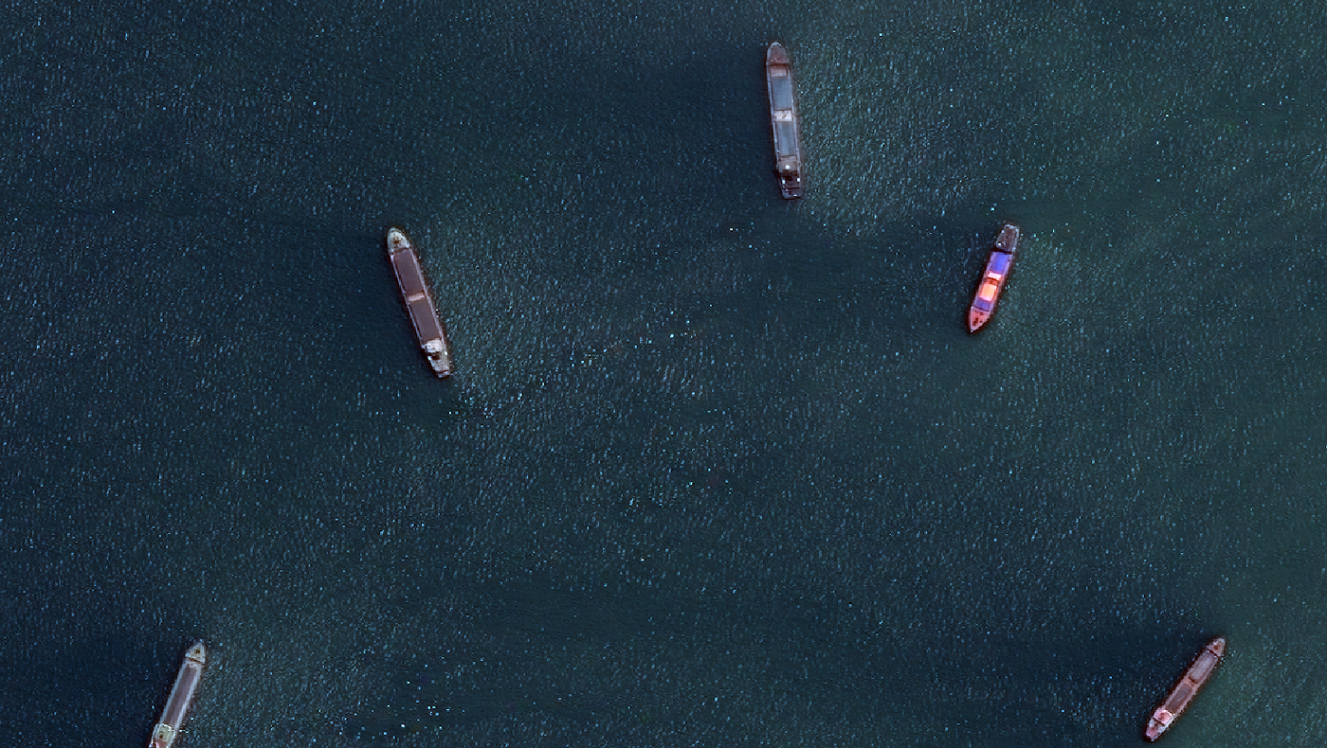
ANY QUESTIONS ?

Slide 23

Thank You

